Slide 1

DNA GAME
2011510105 Berkay TÜRKGELDİ
2011510026 Nurşah DOST
2011510080 Seyhun Yaşar ÖZKAL

Slide 2
CONTENTS
ABOUT THE PROJECT
GAME RULES
WORK PROGRESS
STRING OPERATIONS
FUNCTIONS
IMPROVEMENTS
PROBLEMS - SOLUTIONS

Slide 3
ABOUT THE PROJECT
The name of the project is DNA game
The aim of the project is to develop a tetris game and in the game, the player will construct DNA using tetris blocks and try to gain highest score
Game is played on 12 x 6 board

Slide 4
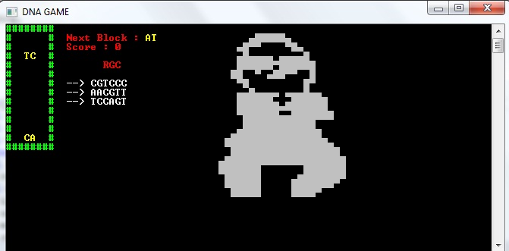

ABOUT THE PROJECT

Slide 5
GAME RULES
During the game, randomly generated active block pairs appear at the top of the game area, then starts to fall
Player can move the active block to the left or to the right
Player can rotate the active block with «R» key
If a horizontal line of molecules is constructed, this line will be copied for second phase. (If two lines is constructed at the same time, second line will be copied also for second phase after first line)

Slide 6
GAME RULES
User should enter the pair of the constructed line. If the string of twisted pair had successfully entered, calculation of score begins
If the user enters twisted pair correctly, line disappear
While entering twisted pair, game play stops for 10 seconds
After calculation of score, game continues
A one-block bomb (X) can be constructed and start to fall. If the bomb touches a character, the character will disappear

Slide 7

WORK PROGRESS
First Week
Second Week
Third Week
Fourth Week
Final Week

Slide 8
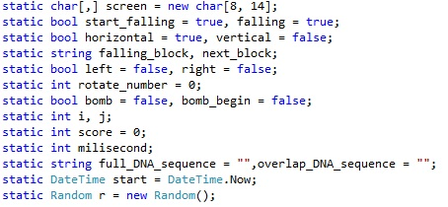
First Week
Definition of variables
«We used some variables static»

Slide 9
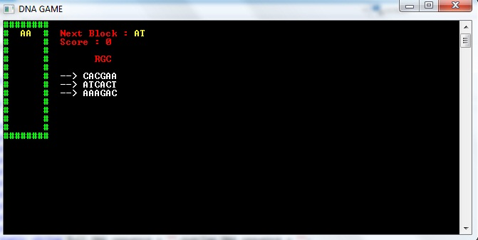
First Week
Construction of screen, RGC lists and falling block

Slide 10
Second Week
Movements of double block
→ Left, right movements
→ Rotate movements
→ Horizontal and vertical logic
Construction of bomb conditions

Slide 11

Third Week
Some string operations
Stirng operations is used in functions generally

Slide 12
Fourth Week
Scoring
→ one of RGC means +30 points
→ reverse of RGC means +20 points
→ anagram of RGC means +15 points
DNA construction

Slide 13

Final Week
Testing
Improvement

Slide 14
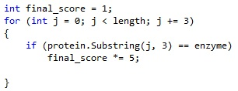
STRING OPERATIONS
Concat
Substring

Slide 15
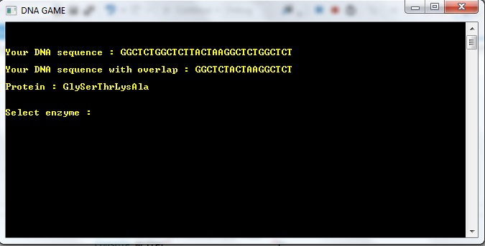
STRING OPERATIONS
Substring

Slide 16
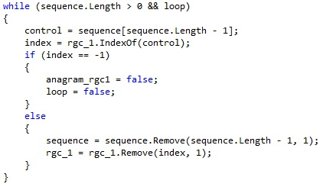
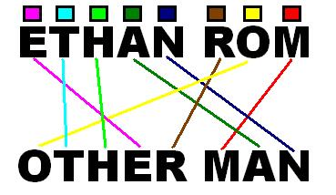
STRING OPERATIONS
Indexof and remove (in anagram function)
Insert

Slide 17
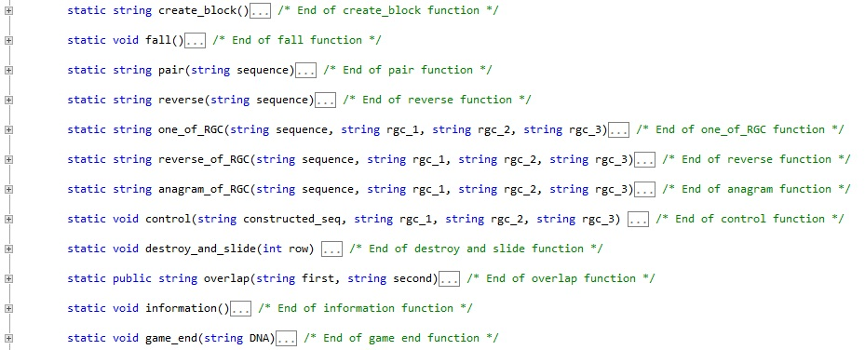
FUNCTIONS

Slide 18
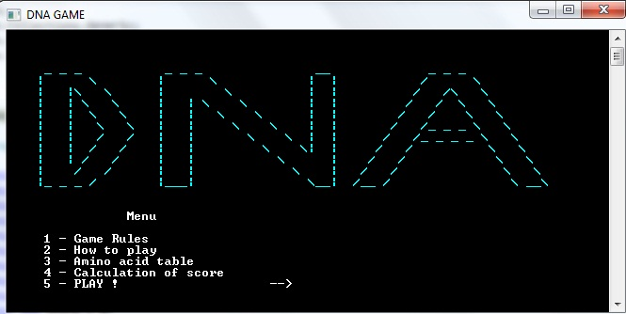
IMPROVEMENTS
Menu for the game

Slide 19
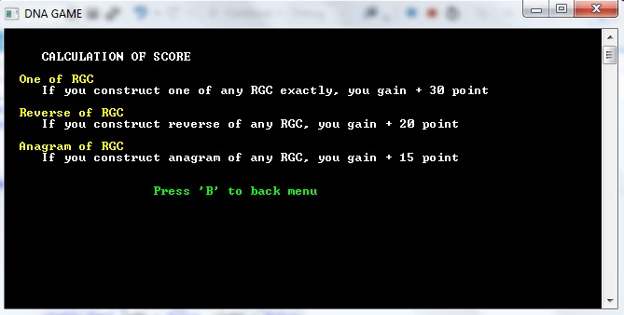
IMPROVEMENTS

Slide 20

IMPROVEMENTS
We added a selection for user to specify degree of difficulty at the beginning of the game
We used «DownArrow» key to fall the blocks immediately
We added pause button ‘P’

Slide 21


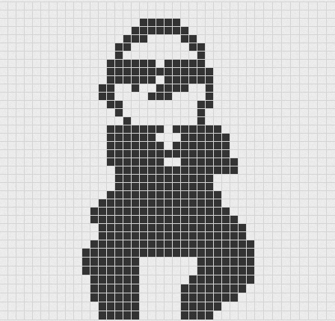
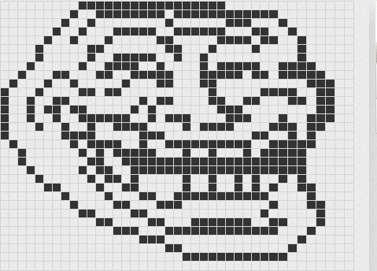
IMPROVEMENTS
ASCII Art
You can check out in www.pictoriano.com/

Slide 22
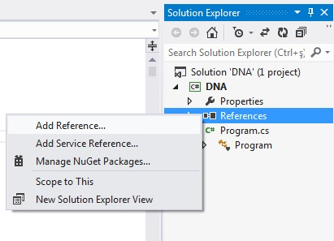
IMPROVEMENTS
We added mp3 file in our project
Firstly we added wmp.dll library

Slide 23
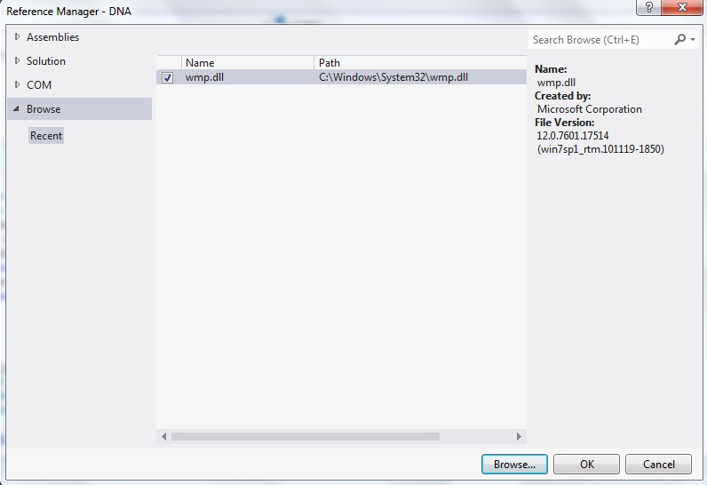
IMPROVEMENTS
Browse → \C:\Windows\System32\wmp.dll (ADD it !)

Slide 24
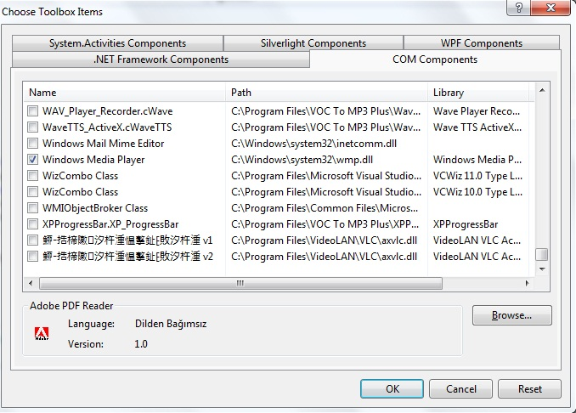
IMPROVEMENTS
Then, we added Windows Media Player component

Slide 25
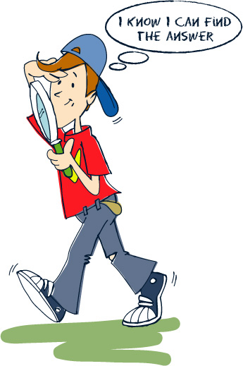
PROBLEMS AND SOLUTIONS
Problem
When we start to use bomb,
we encountered a problem that the
bomb could overflow from table
Solution
We defined bomb as a one
character and we did not use the
pair operations for this character.
We used boolean variable for bomb

Slide 26
PROBLEMS AND SOLUTIONS
Problem
When a block is falling,
sometimes the block stopped
immediately
Solution
We used (>=) comparison
instead of (==)

Slide 27
PROBLEMS AND SOLUTIONS
Problem
While entering twisted pair,
game stops for 10 seconds. When we
count down the time, in the screen,
the time variable display blinked
constantly
Solution
We added an if condition into
while loop and if condition is
processed every one second

Slide 28
PROBLEMS AND SOLUTIONS
Problem
When user enter the pair of the
constructed line, entered characters
appeared beside time display
Solution
We added «true» expression
within into Console.ReadKey( )

Slide 29

ANY QUESTIONS ?

Slide 30
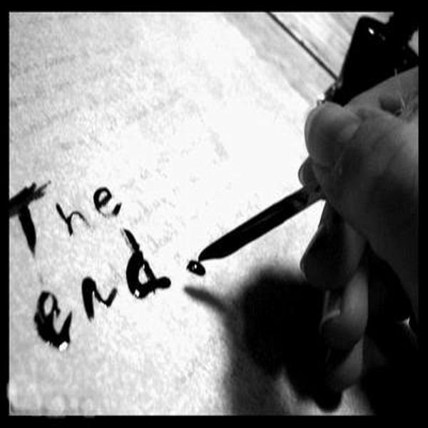
THANK YOU FOR LISTENING

